Slide 1
Arkansas Movies n’ Actors Capstone II Project Presentation
By: Nicholas Bryan

Slide 2
Client Background
Client needed a website highlighting Arkansas film heritage.
Wanted at least 5 to 8 movies and actors to showcase.
Audience: Ages 20 to 40 years old.
Goal: Create a modern and simple to navigate website.

Slide 3
Problem Definition Review
No unified Arkansas film and actor website existed.
Users had to manually search multiple websites.
No content or API integration before project.
Needed responsive, Simple, and easy to update system.

Slide 4
Project Objectives
Create a website listing Arkansas movies and actors.
Integrate TMDB API for movie and actor data.
Implement modal popups for detailed information.
Create using GitHub Pages.
Track usage with Google Analytics.

Slide 5
System Analysis Overview
Web-based architecture.
TMDB API as primary data provider.
Frontend-only system (HTML/CSS/JS).
Static hosting using GitHub Pages.

Slide 6
Tools and Technologies
HTML, CSS, JavaScript.
TMDB API.
GitHub Pages Deployment.
Google Analytics.

Slide 7

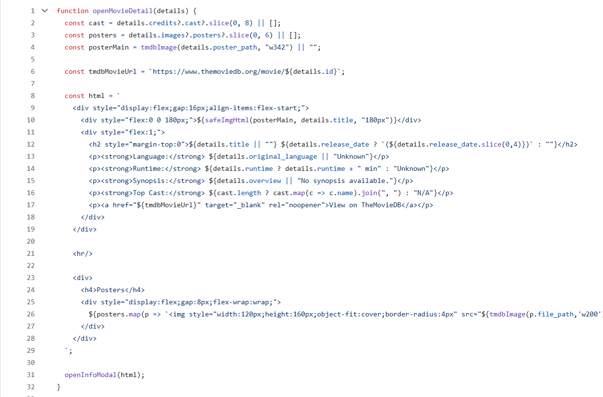
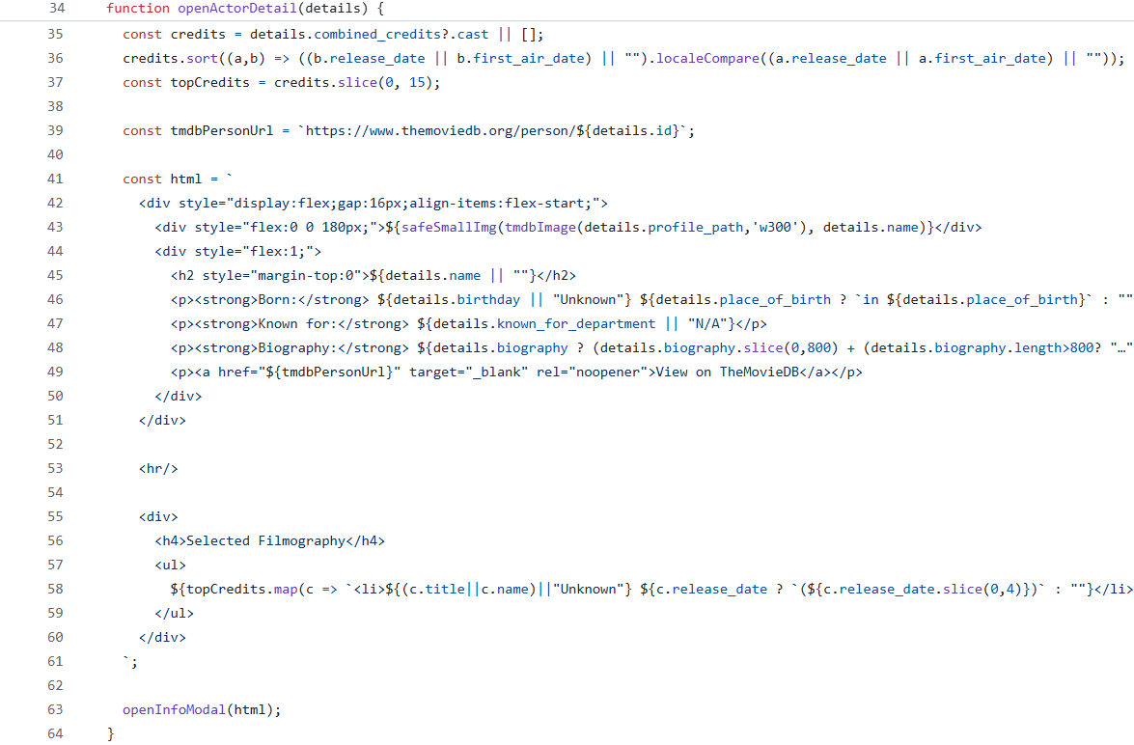
Design Overview
Modular JS files for maintainability.
Reusable modal system for detailed info.
Card grid layout for movies and actors.
Homepage has featured actors and movies.
Consistent styling across all pages.

Slide 8
TMDB Conceptual ERD
TMDB entities used:
Movie: id, title, runtime, genres, overview, poster path, release date.
Person: id, name, biography, birthday, profile path.
Credits: list of actors involved in a film.
Configuration: image base URLs.
These entities form relationships like a relational database but are consumed via API.

Slide 9
Data Flow
First, User loads page.
Second, JavaScript fetches data using TMDB API.
Third, Response returns JSON movie or person objects.
Fourth, DOM renders results.

Slide 10
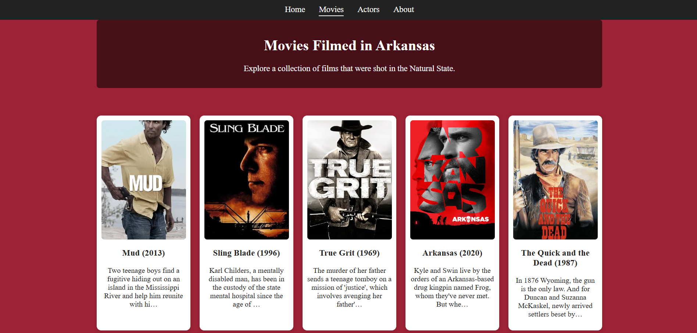
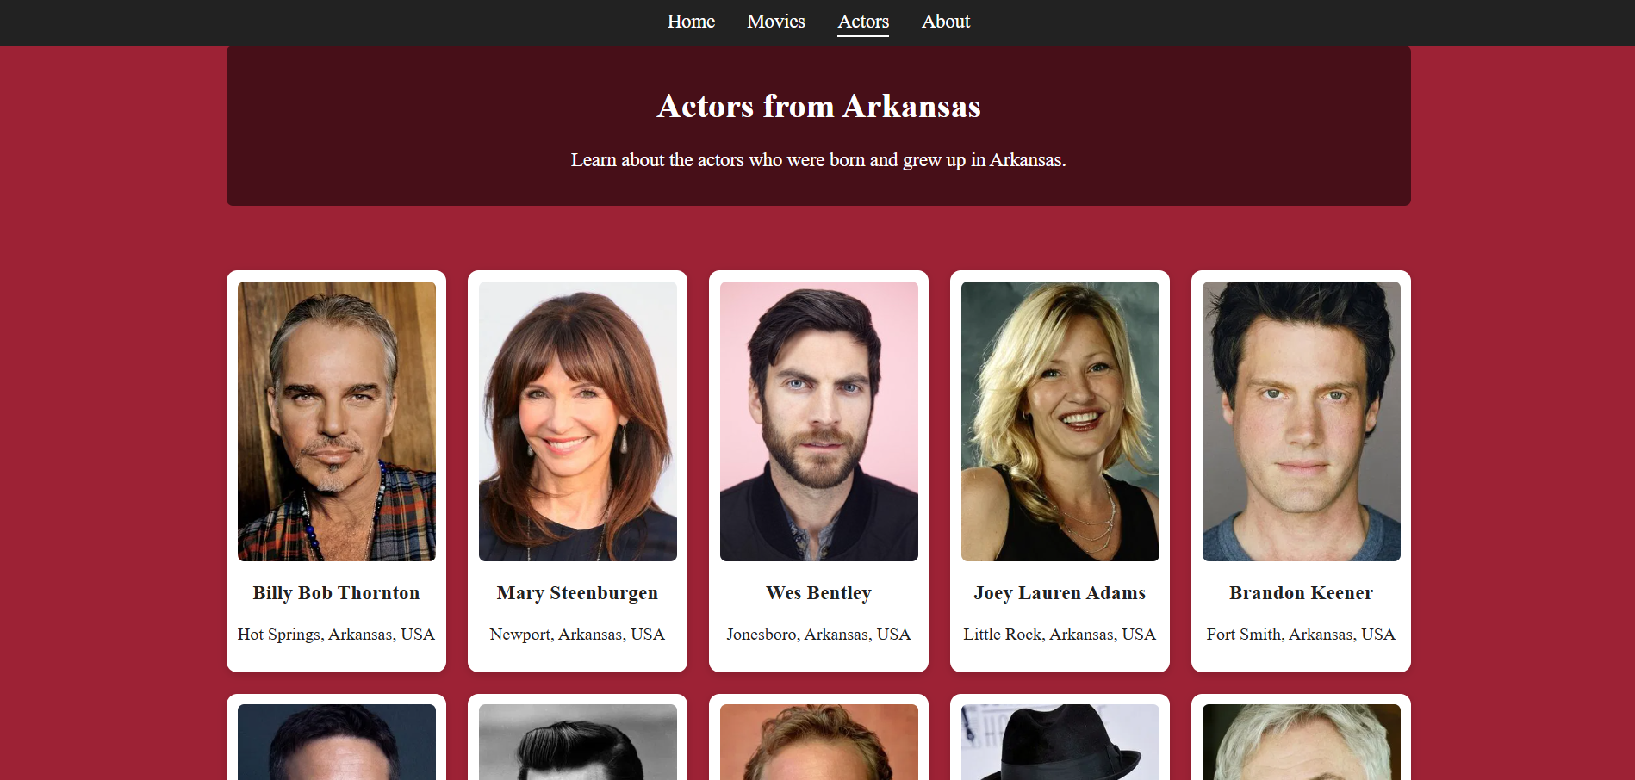
Navigation and Interactions
Navigation consists of a shared navbar linking all pages. User interactions include movie and actor grid selections, modal pop‑ups, menu navigation, featured content interactions, and responsive layout adjustments.

Slide 11
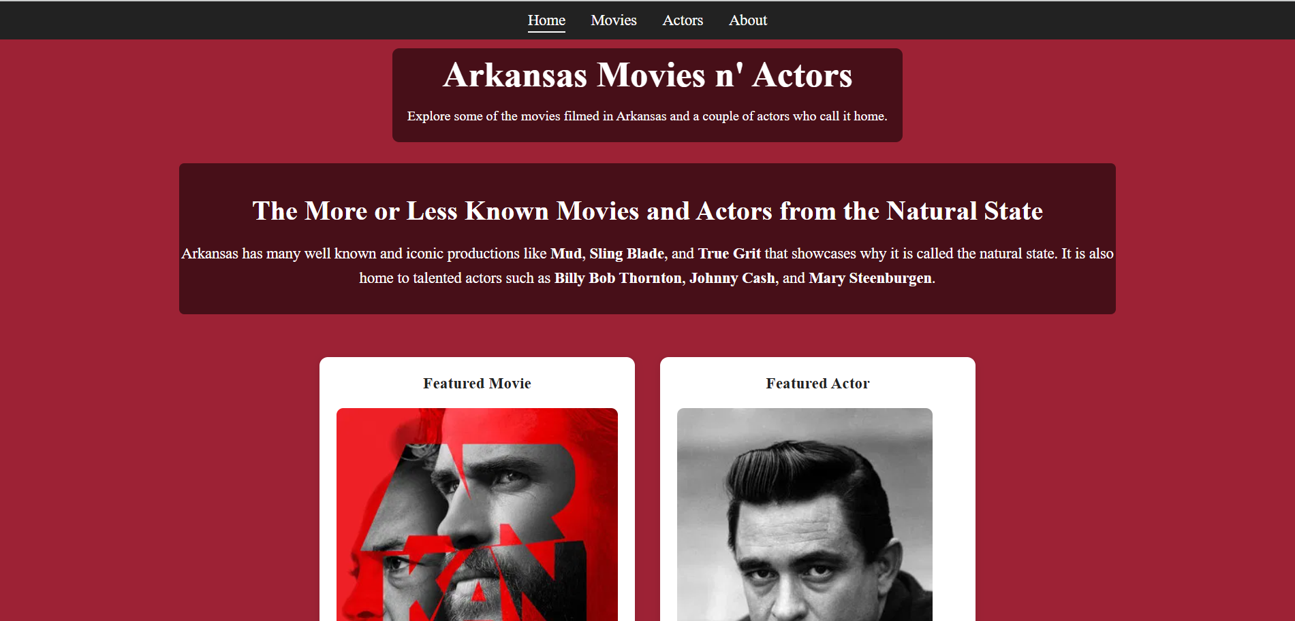
Design Choices
Modal-based display for detailed information.
Featured content for homepage.
Grid layout optimized for readability.
Arkansas-inspired color palette.

Slide 12
Testing Summary
Verified modal interactions.
API handling.
Mobile responsiveness confirmed.
Verified TMDB links & navigation.

Slide 13
Project Outcomes
Fully functional movie and actor database site.
Clean visuals and consistent UI.
Easy future expansion.
Meets all client requirements.

Slide 14
Future Enhancements
Search functionality.
Map view of filming locations.
User ratings or favorites.
Better filtering options.

Slide 15
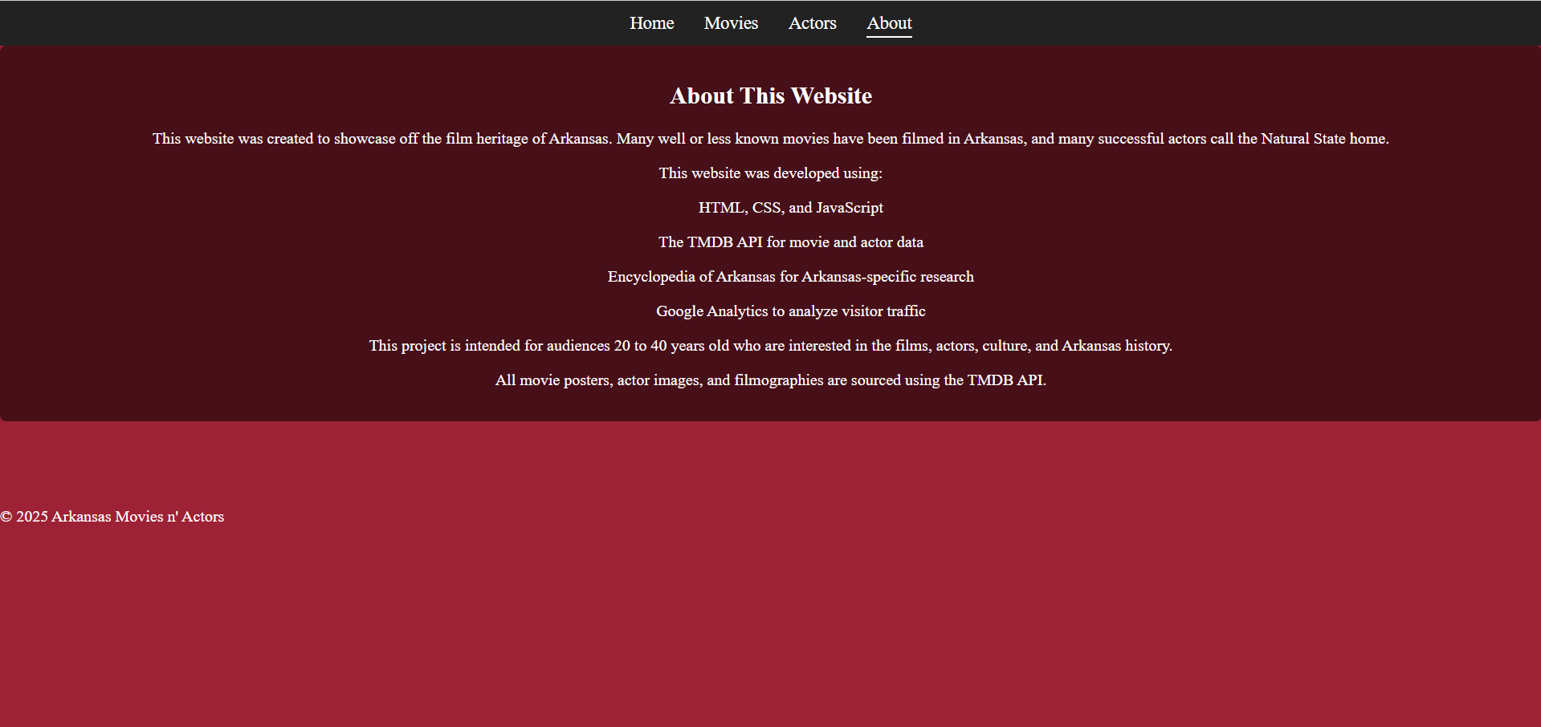
Conclusion
The project demonstrates strong API integration, frontend development, UI design, testing, and documentation. The Arkansas Movies n’ Actors Website meets all client goals effectively.

